Slide 1
CPD Crime project
The dataset that we performed our analysis on was founded within the data.gov website.
Dataset based on data provided from CPD (Chicago Police Department) for crimes in 2016 and 2017 time frame.
Dataset was gathered from https://www.data.gov/.
https://catalog.data.gov/dataset/crimes-2001-to-present-398a4

Slide 2
Project Summary
The dataset that we performed our analysis on was founded within the data.gov website.
This dataset had data for crimes in Chicago from 2001 to 2018; we narrowed our analysis to only focus on the years of 2016 and 2017 crime data.
Our goal was to check for trends on when and where crime was committed, focusing on (time of day/month, was there an arrest, location and finally the district with highest crime rate).

Slide 3
Questions we wanted to tackle with our dataset
When was the crime committed within a month per year, and then within a day?
How many crimes compared to crime type? How many arrests/not arrests per the crime type?
What types of locations did most crimes occur and does the location type have an impact on the number of thefts in a district?
What was the total crime per district? What was the district that had the most theft crime?

Slide 4
Ted’s Analysis
Crime continues to rise in peaks in summer months, and then drastically drops off between sept and oct. Stays pretty steady the rest of the year. Crime is also higher in the first 9 days of the month.

Slide 5
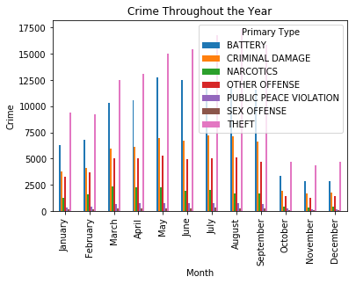
Crime Throughout the Year

Slide 6
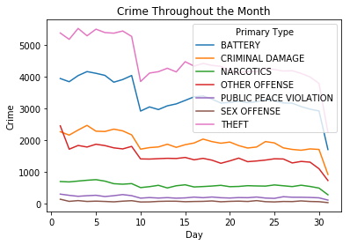
Crime Throughout the Month

Slide 7
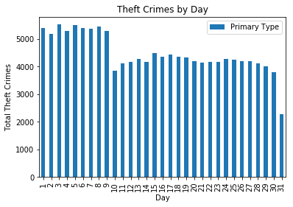
Focus on Theft Crime (Highest Crime Rate)

Slide 8
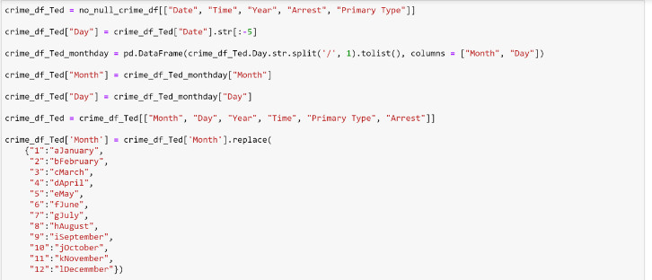
Code development

Slide 9
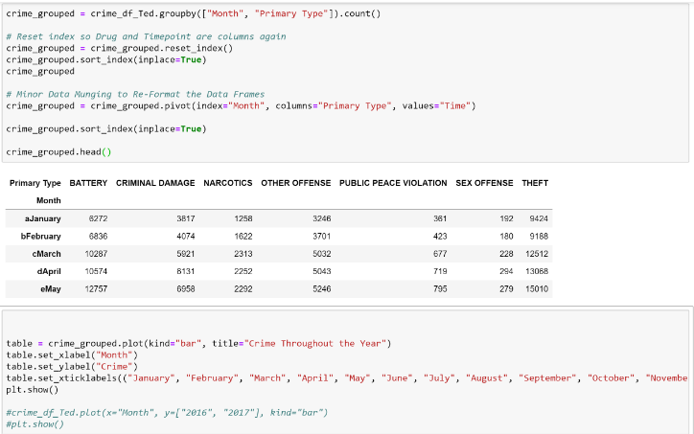
Code development

Slide 10
Anna’s Analysis
I discovered that, compared to the other crime types, Theft had almost 35,000 more crimes than the next closest crime type, which was Battery. But the largest gap was actually between Battery and Criminal Damage with over 43,000 more Battery crimes than Criminal Damage. (2nd graph) Even though Theft had the most crimes, Battery actually had the most Arrests.

Slide 11
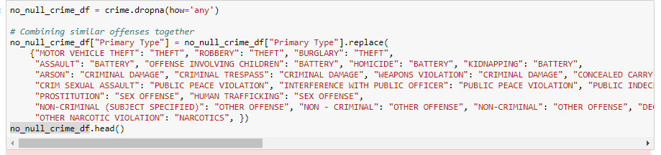
Code development

Slide 12
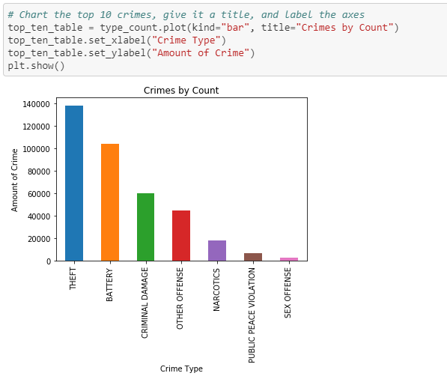
Code development

Slide 13
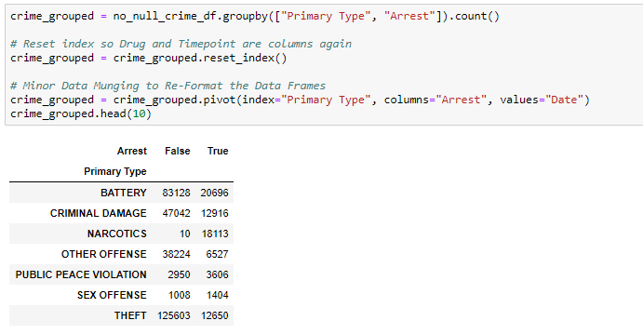
Code development

Slide 14
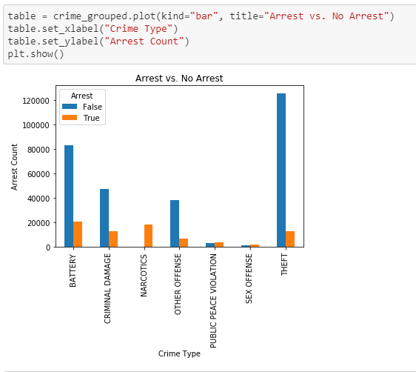
Code development

Slide 15
Kyle’s Analysis
Most crimes occur in Residential and streets/sidewalks. Total theft crimes seen to have a larger percentage on streets/sidewalks compared to residential area. District that had the highest theft rate had majority in retail and private buildings. District with lower had most theft crime in residential and streets/sidewalks.

Slide 16
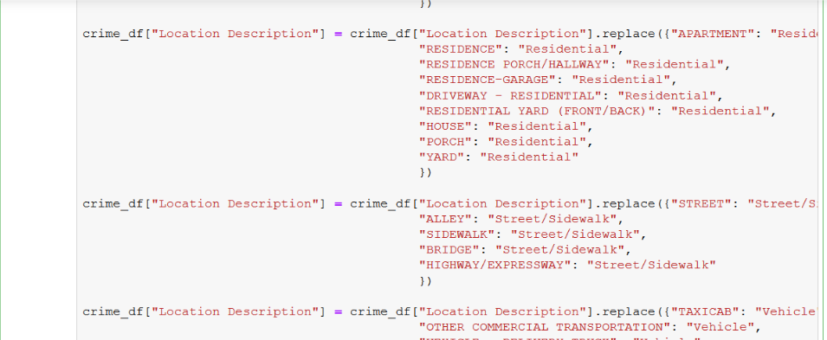
Code development

Slide 17
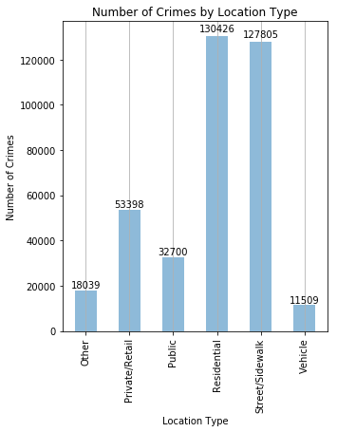
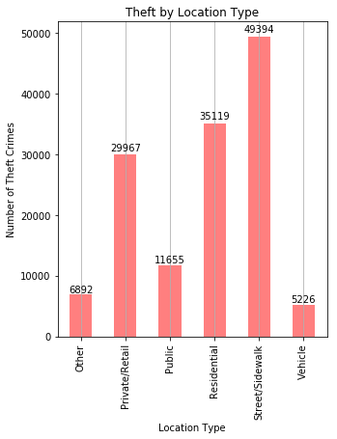
Code development

Slide 18
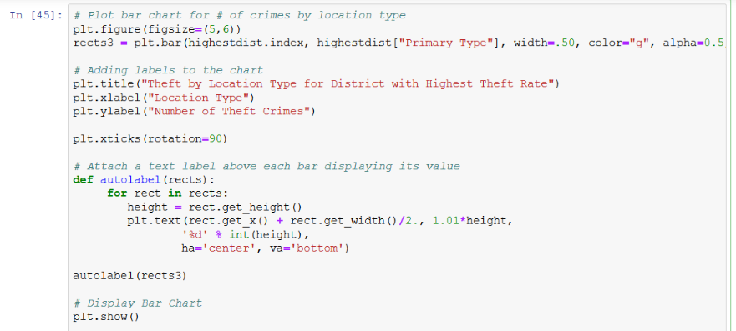
Code development

Slide 19
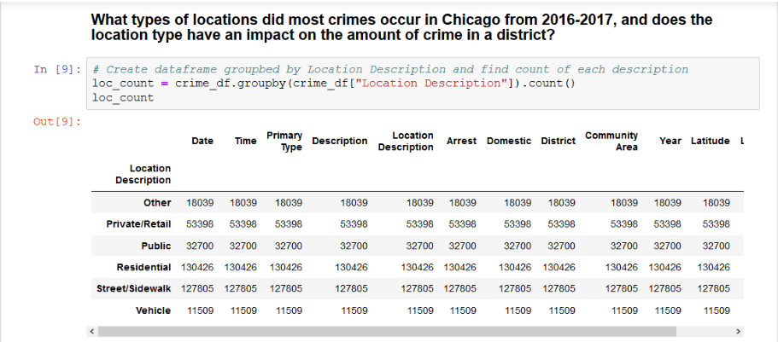
Code development

Slide 20
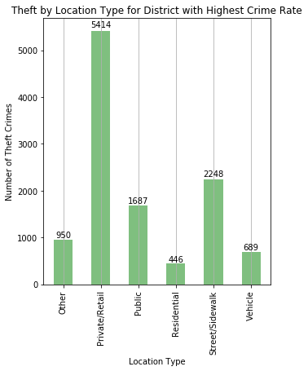
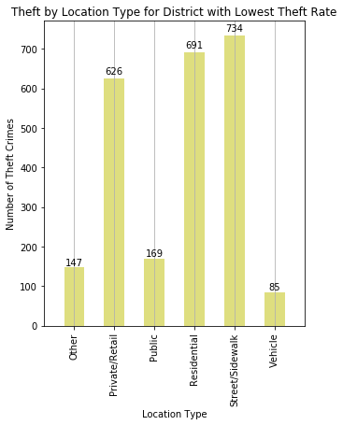
Code development

Slide 21
Jaber’s Analysis
Analyzed our dataset, looking for the district with the highest overall crime rate. Harrison District was the highest district with total crime of 26,142. Step 2 was to focus my analysis on theft as it represented 37% of total crimes for 2016 and 2017. The highest theft crime was in the Central District with total theft crime of 11,434 which equal to 8.3% to total theft crimes from within the 25 districts.

Slide 22
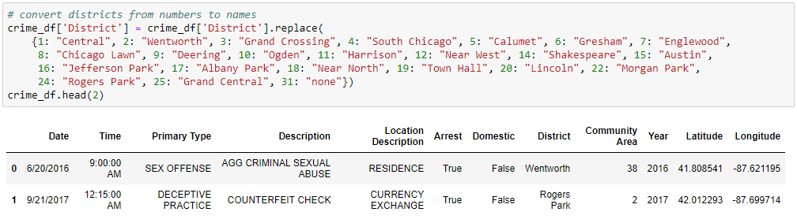
Code development

Slide 23
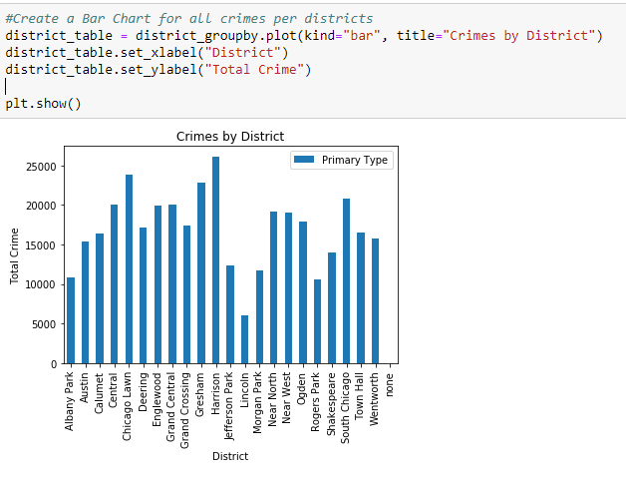
Code development

Slide 24
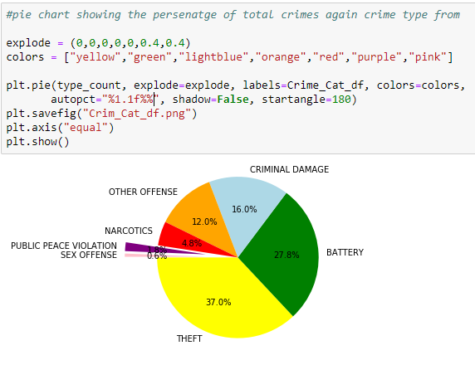
Code development

Slide 25
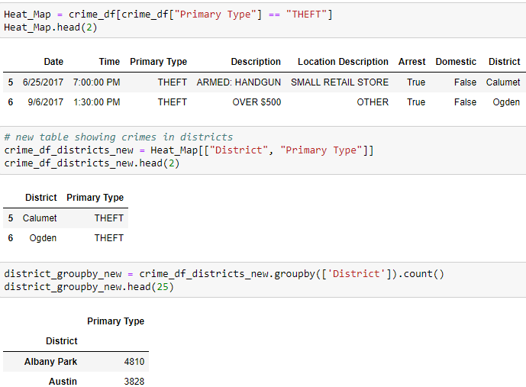
Code development

Slide 26
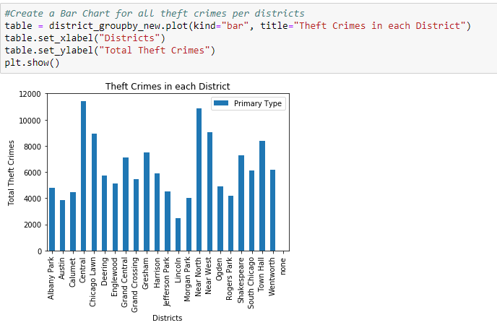
Code development

Slide 27
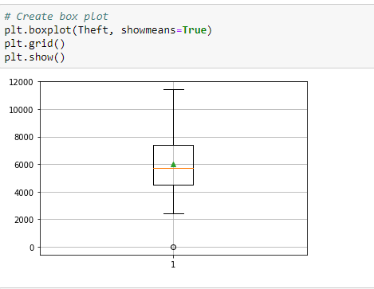
Code development

Slide 28
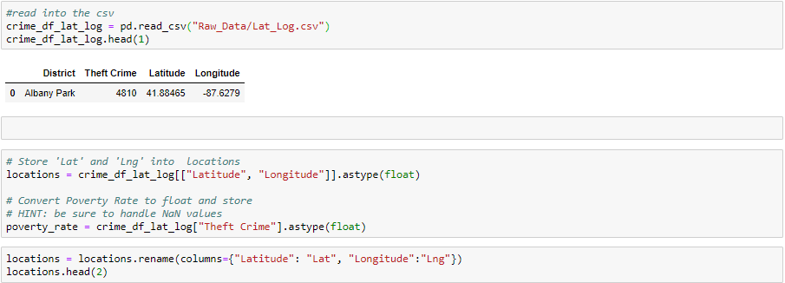
Code development

Slide 29
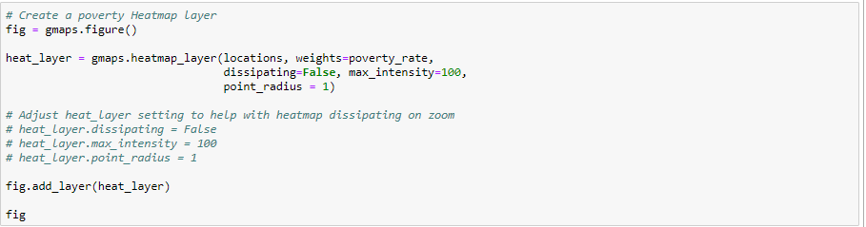
Code development

Slide 30
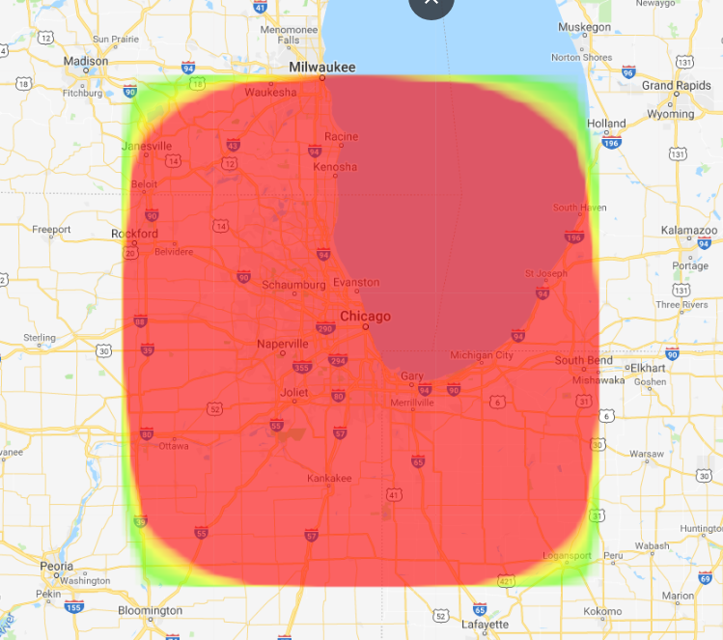
Code development

Slide 31
Conclusion
Increasing patrolling in the summer months (as the weather gets warmer) as well as in the first 2 weeks of each month. More arrests for theft, so maybe put more cameras around street/sidewalks areas. Increase surveillance.
Out of 138,253 thefts crimes total, only 10% actually get arrested for such crime.
Focus more on patrolling around residential areas and sidewalk as most of the crimes take place in such locations, as well as focus more on the Central district as it represented the 2nd highest districts in the overall crimes rate and the number 1 district with theft crimes in 2016 and 2017.

